Slide 1
EIP-7939 — Count Leading Zeros (CLZ)
The Tiny Opcode That Makes Ethereum 60× Faster | Fusaka Upgrade 2026

Slide 2
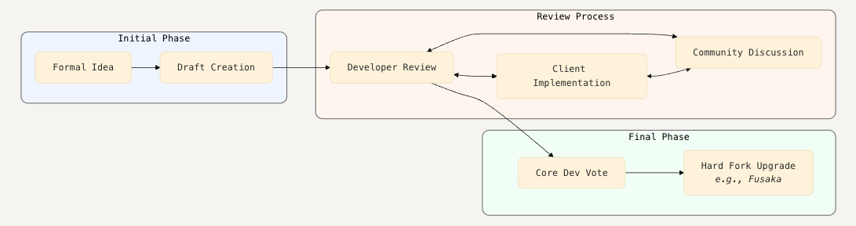
What is an EIP?
Ethereum Improvement Proposal = EIP

Slide 3
EVM = Ethereum Virtual Machine
The “computer” that executes every Ethereum smart contract
Stack-based architecture — uses a stack to execute opcodes (PUSH, POP, ADD, etc.)
Operates on 256-bit words (everything is 32 bytes wide)
No floating-point arithmetic
No CLZ (Count Leading Zeros) — until now
Executes all smart contracts
Stack-based 256-bit architecture
Missing basic bit-math ops (CLZ, CTZ)

Slide 4
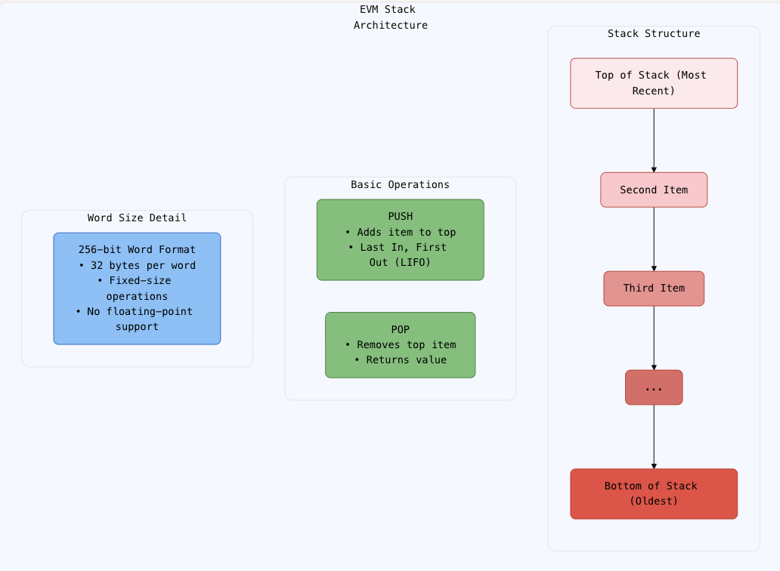

Slide 5
What Is EIP-7939?
EIP-7939 is an Ethereum Improvement Proposal to add a new instruction to the Ethereum Virtual Machine (EVM) — the engine that runs all smart contracts.
The instruction is called CLZ → Count Leading Zeros.
What does it do?
You give it a 256-bit number (like 0x000...001).
It counts how many zeros are at the beginning (from the left, i.e., Most Significant Bit).
It returns that count (0 to 256).
If the number is zero, it returns 256.
Example:
0x8000...0000 → CLZ → 0 (no leading zeros)
0x0000...0001 → CLZ → 255 (255 leading zeros)
0x0000...0000 → CLZ → 256 (all zeros → special case)

Slide 6
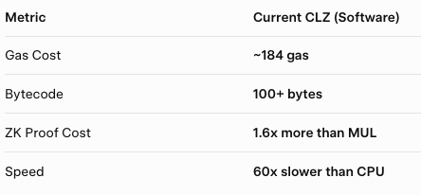
Why Was This Needed?
The EVM is great at security, but terrible at math.
Today, if a smart contract wants to:
Calculate log2(x)
Compute sqrt(x)
Find the most significant bit (MSB)
Compress data
Run ZK proofs
…it has to simulate CLZ using dozens of EVM instructions like:
SHR, LT, OR, XOR, BYTE, ISZERO…
The Cost Today:
Result:
DeFi apps pay huge gas.
ZK rollups prove slowly.
Contracts are bloated.

Slide 7
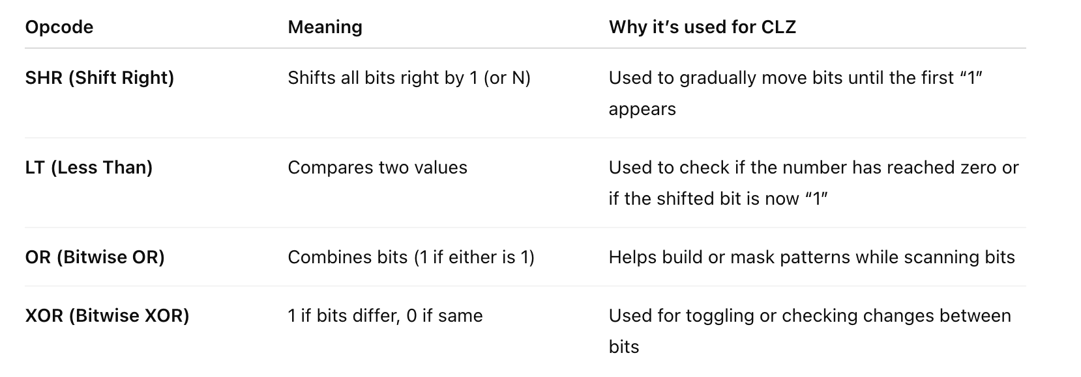
When the EVM doesn’t have a Count Leading Zeros (CLZ) instruction, developers must manually build that logic using basic bitwise operations.

Slide 8
EIP-7939 Adds CLZ Opcode
“Stop simulating. Just add CLZ as a real EVM instruction.”
Technical Spec (Official)
New Opcode: 0x1e
Name: CLZ (Count Leading Zeros)
Gas Cost: 5 gas only
Stack Input1 × 256-bit word
Stack Output1 × count (0–256)
Gas Cost5 gas
Zero InputReturns 256
StatusLast Call (Oct 28, 2025)
UpgradeFusaka (Q1 2026)
Returns :0 – 256
Purpose: Hardware-style bit counting — no loops
Status: Last Call → Coming in Fusaka 2026 upgrade
Why 5 gas?
Same tier as MUL
Prevents DoS (not too cheap)
Still 36x cheaper than current code

Slide 9
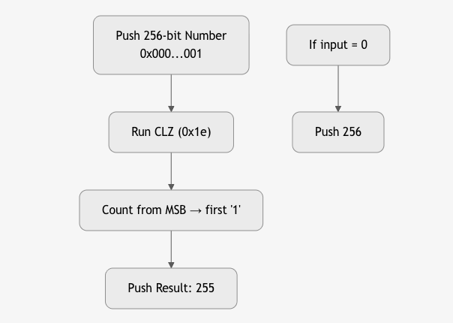
How CLZ Works
Binary: 00000000 00000000 ... 00000001
↑↑↑↑↑↑↑↑↑↑↑↑↑↑↑↑↑↑↑↑↑↑↑↑↑↑↑↑↑↑↑↑↑
255 leading zeros → CLZ returns 255

Slide 10
Before CLZ — Current Software Emulation
Code (EVM Assembly / Solidity)
Use this as-shown — it’s a simplified real version of what’s currently the fastest known CLZ emulation on the EVM (taken from EIP discussions and optimized libraries like Solady).
function clz(uint256 x) internal pure returns (uint256 r) {
assembly {
// Binary search over 256 bits
r := shl(7, lt(0xffffffffffffffffffffffffffffffff, x))
r := or(r, shl(6, lt(0xffffffffffffffff, shr(r, x))))
r := or(r, shl(5, lt(0xffffffff, shr(r, x))))
r := or(r, shl(4, lt(0xffff, shr(r, x))))
r := or(r, shl(3, lt(0xff, shr(r, x))))
// The final step uses a lookup table (omitted for brevity)
// to get the last few bits right
r := add(xor(r, byte(0x00, 0xf8f9fa...)), iszero(x))
}
}
Code (Future Solidity, after Fusaka 2026)
assembly {
let result := clz(x) // New EVM opcode 0x1e
}
you just call clz(x).
One line, one opcode, 36× cheaper, and 90% smaller bytecode.”

Slide 11
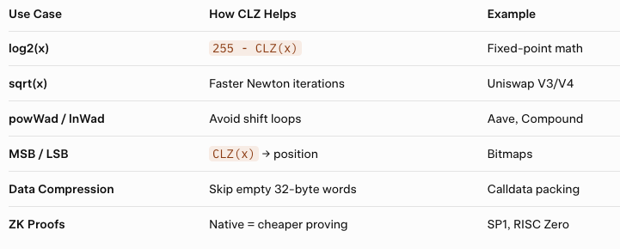
Powerful Use Cases

Slide 12
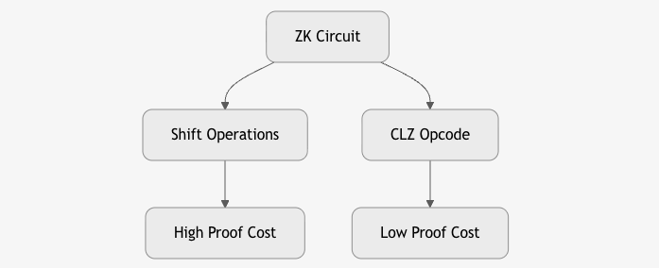
ZK & Rollup Impact — Why CLZ Matters for Zero-Knowledge Proofs
Before CLZ:
ZK circuits emulate shifts → higher constraints
→ expensive proof generation → slower rollups
After CLZ:
Native bit-count (CLZ 0x1e) in EVM
→ fewer constraints
→ faster proving
→ cheaper rollups
→ more private on-chain computation
CLZ = cheaper ZK math. Faster proofs. Lower rollup cost.

Slide 13
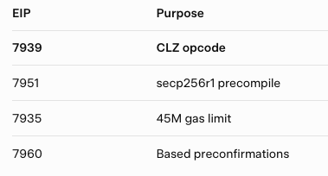
Fusaka Upgrade
Fusaka = Ethereum’s largest post-Pectra upgrade (12 EIPs)
CLZ: the smallest yet most impactful EVM improvement.

Slide 14
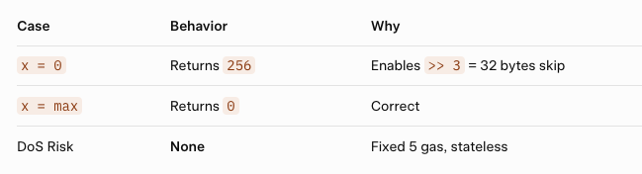
Security & Edge Cases
Backwards compatible — only breaks if you used clz as a variable name (rare)

Slide 15
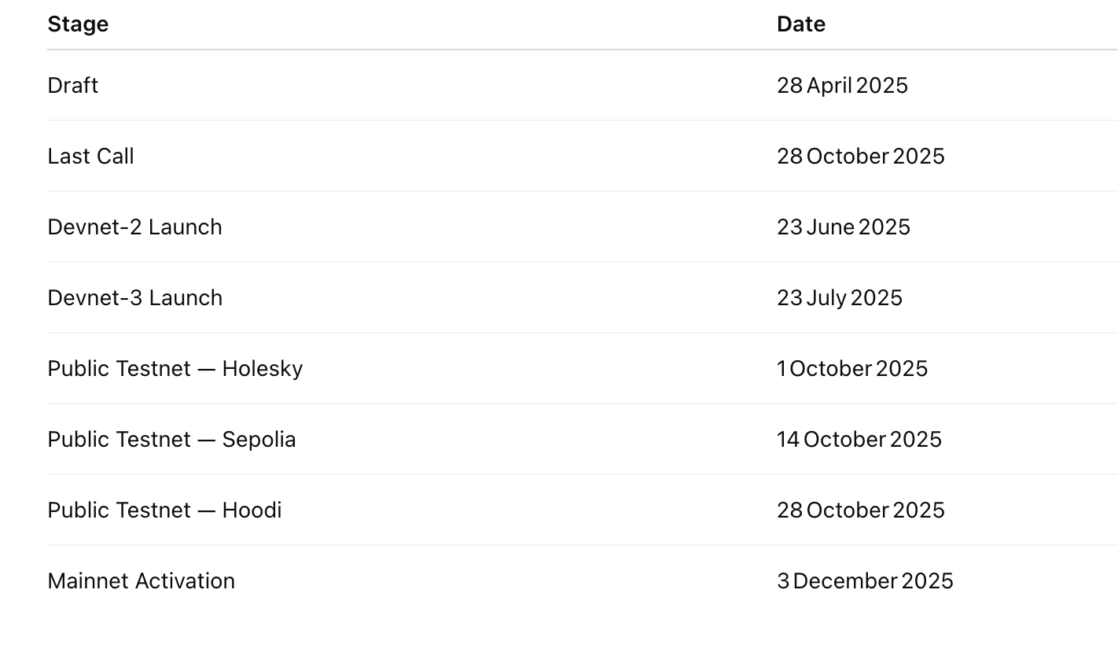
EIP-7939 Timeline (Fusaka Upgrade)

Slide 16
Authors & Community
Lead: Vectorized (@Vectorized) — Solady dev
Co-authors: Georgios Konstantopoulos (@gakonst), Jochem Brouwer, Ben Adams, Giulio Rebuffo
Discussed: Ethereum Magicians
Deep Dive: PEEPanEIP #153 (YouTube)

